Slide 1
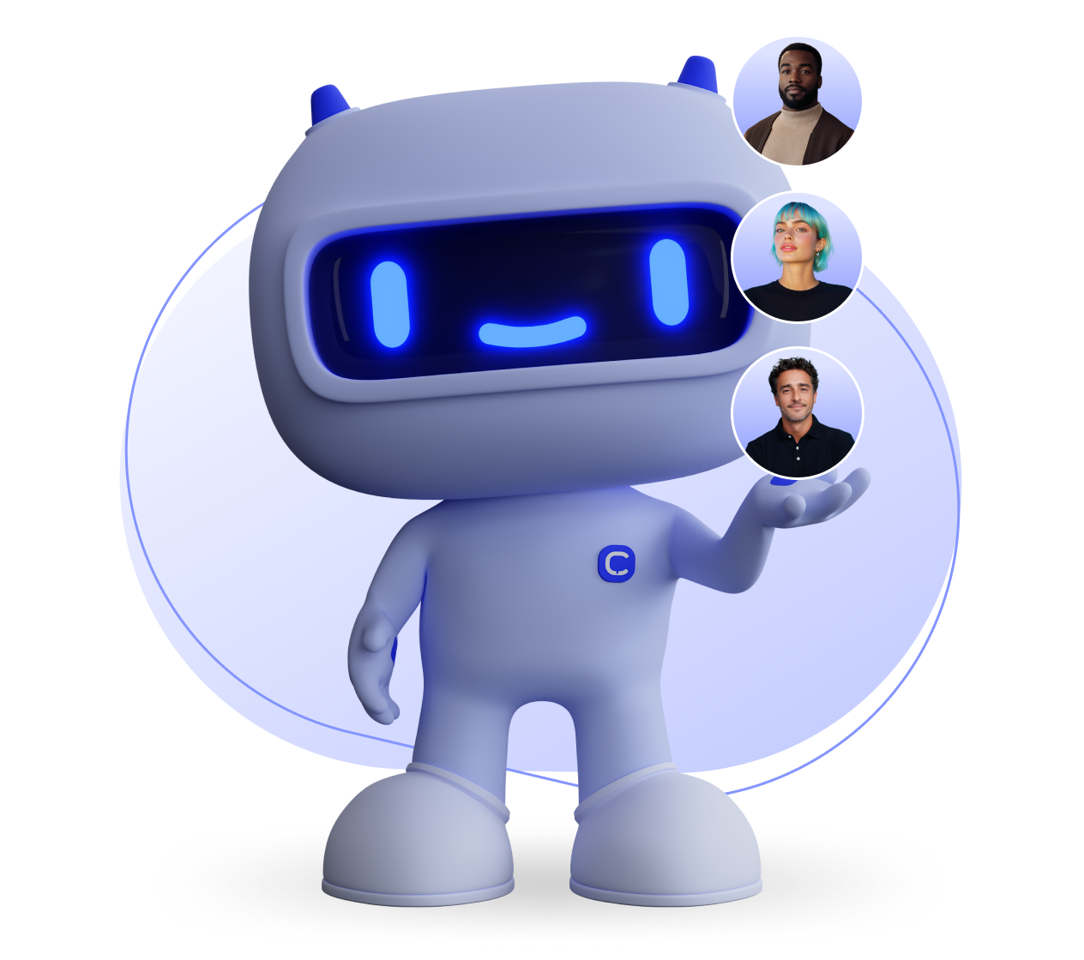
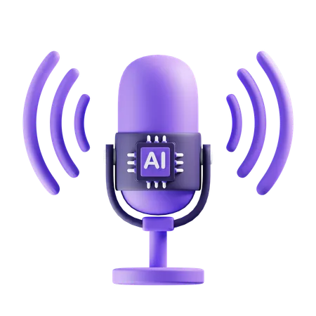
Group Temp
Project Proposal
AWS Project - AI Voice Agent

Slide 2
Team Temp
Team Members:
Madina Maingua - Team Lead; Front-End Developer
Sayed Babiker - Front-End Developer
Chukwudera Duru - Back-End Developer
Nathaniel Joseph - Front-End Developer
Alvin Ododa - Back-End Developer
Yashwanth Pentakota - Risk Management / Front - End Developer

Slide 3
Project Description
The AI Voice Agent Platform is a cloud-based system designed to enable real-time, voice-driven interactions with an AI assistant. The project focuses on building a scalable and reliable backend architecture capable of processing spoken input, maintaining conversational context, and generating appropriate responses across multiple turns of dialogue.
The system is implemented using Amazon Web Services (AWS). API Gateway handles incoming requests, while AWS Lambda functions orchestrate speech processing and AI inference within an event-driven workflow. DynamoDB is used to store session and conversation state, allowing the agent to maintain context across user interactions rather than treating each request independently.
A key goal of the project is to explore real-world backend engineering challenges, including low-latency response handling, fault tolerance, and system observability. To address these challenges, the platform incorporates structured logging, request timeouts, and retry and fallback mechanisms to improve reliability under error conditions.

Slide 4
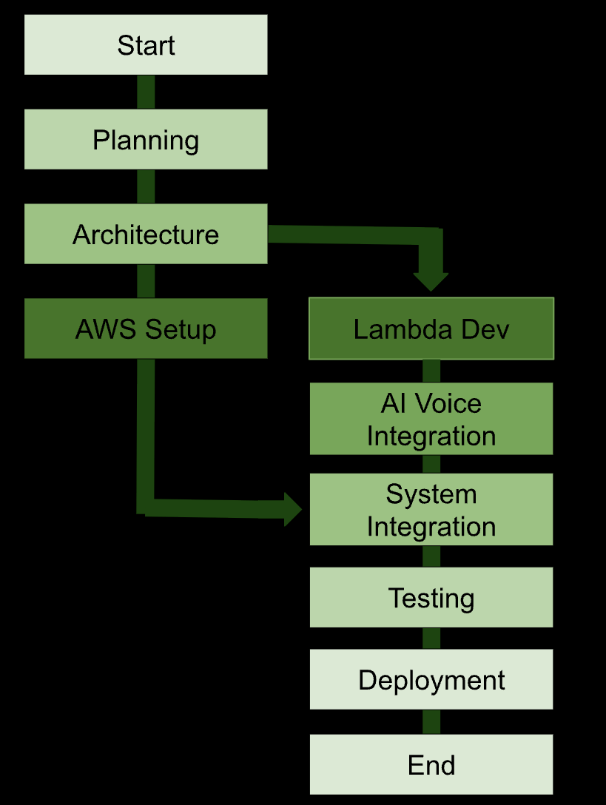
Project Schedule (PERT Chart)
Planning: The goals and requirements are determined.
Architecture: The AWS service and AI voice component integration design is created.
AWS Setup: The Lambda, API Gateway, and DynamoDB setup is completed.
Lambda Development: The backend programming using Python is done.
AI Voice Integration: The speech-to-text and text-to-speech functionality is added.
System Integration: The infrastructure, backend, and AI voice system integration is completed.
Testing: The system is tested, and problems are solved.
Deployment: The AI voice agent is deployed.
Tasks are connected when there is a dependency between them. AWS setup and Lambda development will be assigned together after the architecture step, then come together at the system integration step before testing and deployment.

Slide 5
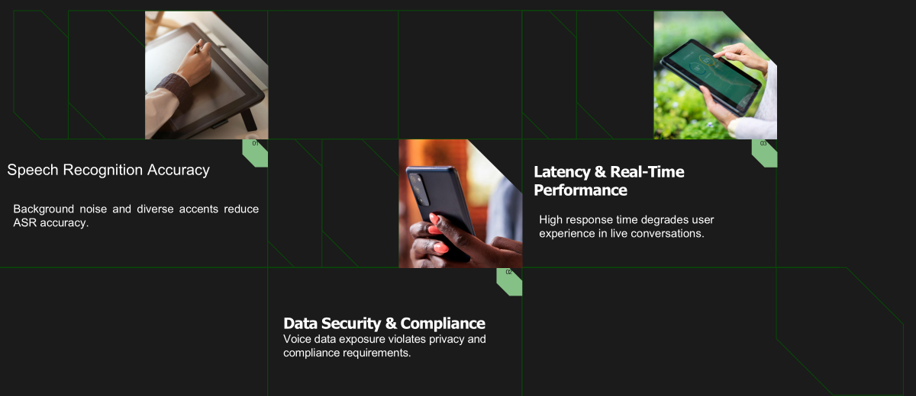



Risk Management (Top-3 Risks)
Product feature
01
03
Product feature
Briefly describe a product feature and how it benefits the user. Bring it to life with clear, vivid language.
Add as many features as you need to describe your product. You can duplicate this slide if you need more items.
02
Product feature
Describe another product feature. Think about how this feature helps solve the problem you identified earlier.

Slide 6
Each Member's Contribution & Responsibilities (%)
Back-End Developer
Contributions:
Help build backend functions for voice input and responses
Manage
conversation data storage
16.6%
Back-End Developer
Contributions:
Set up AWS services for the project
Help connect and prepare the system for launch
16.6%
Madina Maingua
Nathaniel Joseph
Sayed Babiker
Yashwanth Pentakota
Chukwudera Duru
Alvin Ododa
Responsibilities:
Team Lead; Front-End Developer
Contributions:
Manage the project plan and guided the team
Design and help build the main user interface
16.6%
Responsibilities:
Front-End Developer
Contributions:
Create screen layouts and user flows
Helpe test and fix front-end issues
16.6%
Responsibilities:
Front-End Developer
Contributions:
Build user interface features for the voice agent
Help Connect the interface to the backend system
16.6%
Responsibilities:
Front-End Developer / Risk Management
Contributions:
Identify project risks and ways to reduce them
Help with front-end work and testing
16.6%
Responsibilities:
Responsibilities:

